Slide 1







SIMATS ENGINEERING | CSA0504
Slide 1 of 15
Database Management Systems (DBMS)
Assessment Tool 3
Course Code: CSA0504
Presented By: K. Sampath Chaitanya
Register Number:
TECHNICAL SYSTEM DATABASE
Department: CSE (AI)
SIMATS Engineering

Slide 2
1 st question

Slide 3

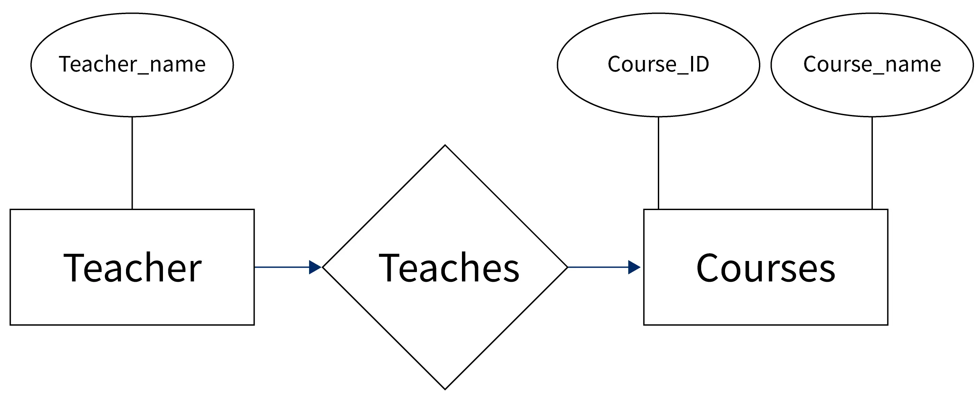

SIMATS ENGINEERING | CSA0504
Slide 2 of 15
ER Diagram for Online Library System
What is an ER Diagram?
ER stands for Entity Relationship Diagram
It is used to design the structure of a database.
It shows:
Entities
Attributes
Relationships
Example
Online Library System stores information about:
Books
Students
Librarians
Borrow Records

Slide 4



SIMATS ENGINEERING | CSA0504
Slide 3 of 15
Components of ER Diagram
Entity
An object stored in the database.
Examples: Student, Book, Librarian
ER NOTATION & SYMBOLS
Rectangle
Attribute
Describes an entity.
Examples: Student ID, Book Title, Author
Oval
Relation
Diamond
Relationship
Connects two entities.
Example: Student borrows Book.

Slide 5





SIMATS ENGINEERING | CSA0504
Slide 4 of 15
Online Library ER Diagram
Student → Borrows → Book
Book → Managed By → Librarian
Borrow Record stores:
• Borrow Date
• Return Date
• Fine
Conclusion: ER diagrams help design databases before implementation.

Slide 6
2 nd question

Slide 7
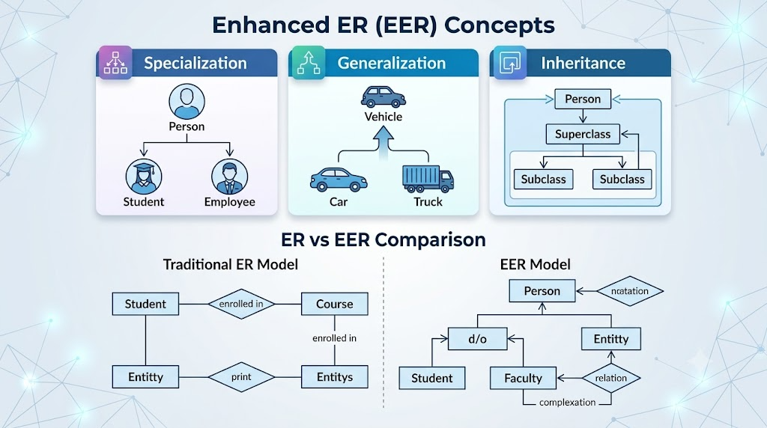
SIMATS ENGINEERING | CSA0504
Slide 5 of 15
Enhanced ER Model
What is EER?
EER stands for Enhanced Entity Relationship Model.
It is an advanced version of the ER Model.
It includes:
Specialization
Generalization
Inheritance

Slide 8


SIMATS ENGINEERING | CSA0504
Slide 6 of 15
GENERALIZATION
SPECIALIZATION
Generalization and Specialization
Generalization
Combines similar entities into one parent entity.
Example
Student, Teacher
↓
Person
Specialization
Divides one parent into child entities.
Example
Person
↓
Student, Teacher

Slide 9









SIMATS ENGINEERING | CSA0504
Slide 7 of 15
University Case Study
University → Person → Student, Faculty, Staff
Common Attributes:
Student:
ID, Name, Phone
Roll Number, Course
Faculty:
Staff:
Roll, Course
Sub, Salary
Department
Subject, Salary
Department
Conclusion: EER reduces redundancy and improves organization.

Slide 10
3 rd question

Slide 11
SIMATS ENGINEERING | CSA0504
Slide 8 of 15
Data Independence
Data Independence means changing one level of the database without affecting another level.
Logical Independence
Types
Physical Independence
•
Physical Data Independence
•
Logical Data Independence

Slide 12

SIMATS ENGINEERING | CSA0504
Slide 9 of 15
Types of Data Independence
Physical Data Independence
Changes in storage do not affect users.
Example:
Changing HDD to SSD.
DBMS
Logical Data Independence
Changes in table structure do not affect applications.
Example:
Adding a new column.

Slide 13

SIMATS ENGINEERING | CSA0504
Slide 10 of 15
Importance of Data Independence
Easy maintenance
Better security
Easy database modification
Reduced application changes
Flexible database system

Slide 14
4 th question

Slide 15




SIMATS ENGINEERING | CSA0504
Slide 11 of 15
Software Components of DBMS
Main Components
Query Processor
Storage Manager
Transaction Manager
These work together to manage database operations.
Flowchart

Slide 16
SIMATS ENGINEERING | CSA0504
Slide 12 of 15
Query Processor
Functions
Reads SQL Query
Checks Syntax
Optimizes Query
Executes Query
SQL Example
The Query Processor finds and returns the required records.

Slide 17




SIMATS ENGINEERING | CSA0504
Slide 13 of 15
Storage Manager & Transaction Manager
Storage Manager
Functions:
• Stores Data • Retrieves Data • File Management • Index Management
Transaction Manager
Functions:
• Controls Transactions • Maintains Consistency • Prevents Data Loss
Real Life Example

Slide 18
5 th question

Slide 19


SIMATS ENGINEERING | CSA0504
Slide 14 of 15
Strong Entity vs Weak Entity
Strong Entity
Has its own Primary Key.
Example
Student Employee
ER DIAGRAM ENTITY REPRESENTATIONS
Single Rectangle
Double Rectangle
Weak Entity
Cannot exist without another entity.
Example
Dependent Order Item

Slide 20



SIMATS ENGINEERING | CSA0504
Slide 15 of 15
Comparison
Strong Entity | Weak Entity
Has Primary Key | No Complete Primary Key
Independent | Dependent
Single Rectangle | Double Rectangle
Example: Student | Example: Dependent

Slide 21
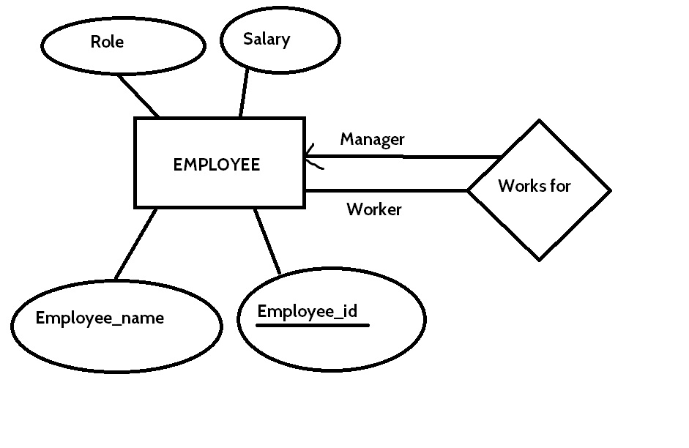
SIMATS ENGINEERING | CSA0504
Slide 15 of 15
Real-Life Example & Conclusion
Real-Life Example
Employee (Strong Entity)
↓
Dependent (Weak Entity)
If Employee record is deleted,
Dependent record is also removed.
Conclusion
Strong entities exist independently, while weak entities depend on strong entities.

